Slide 1


AI Career Compass
Revolutionizing Career Recommendations with AI
By
Mukarram Bambot
Gowtham
Sai Naveen
Sabari Nathan
- PATRICIAN COLLEGE OF ARTS AND SCIENCE
Notes:
1

Slide 2
Revolutionizing Career Recommendations with AI
Traditional Career Guidance
AI-powered solutions
Often based on limited data and subjective opinions
Leverage vast data sets for personalized recommendations
Notes:
2

Slide 3

Problem Statement and Motivation
Limited Career Exploration
Information Overload
Bias and Subjectivity
Difficulty finding relevant information and resources
Traditional methods prone to bias and subjective opinions
Lack of guidance and clarity on suitable paths
Notes:
3

Slide 4
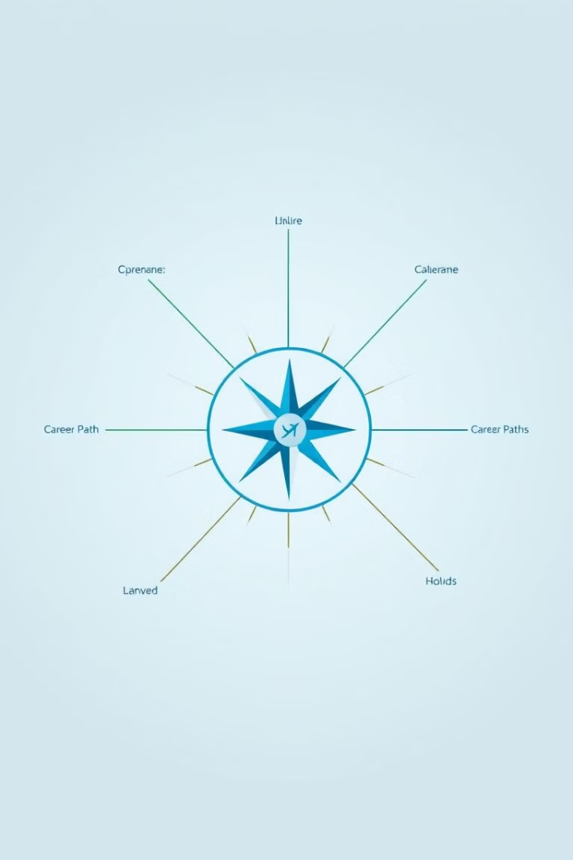
Key Features of AI Career Compass
Personalized Recommendations
Skills and Interest Assessment
Tailored suggestions based on skills and interests
Interactive assessments to identify strengths and passions
Career Path Exploration
Data Visualization
Visual representation of career paths and trends
Detailed information on various careers and their requirements
Notes:
4

Slide 5
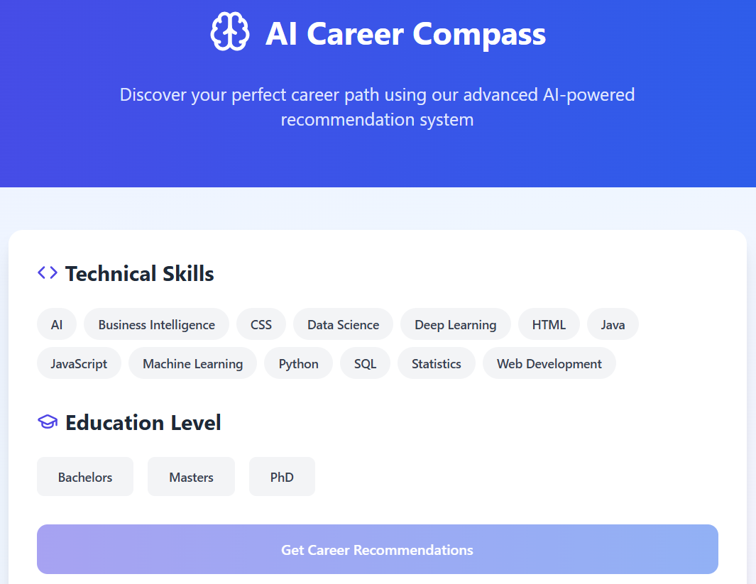



AI-Powered Career Recommendations
Job Market Analysis
Skill Matching
Identifies emerging trends and high-demand roles
Connects users' skills with relevant career paths
Personalized Insights
Provides tailored recommendations based on individual profiles
Notes:
5

Slide 6
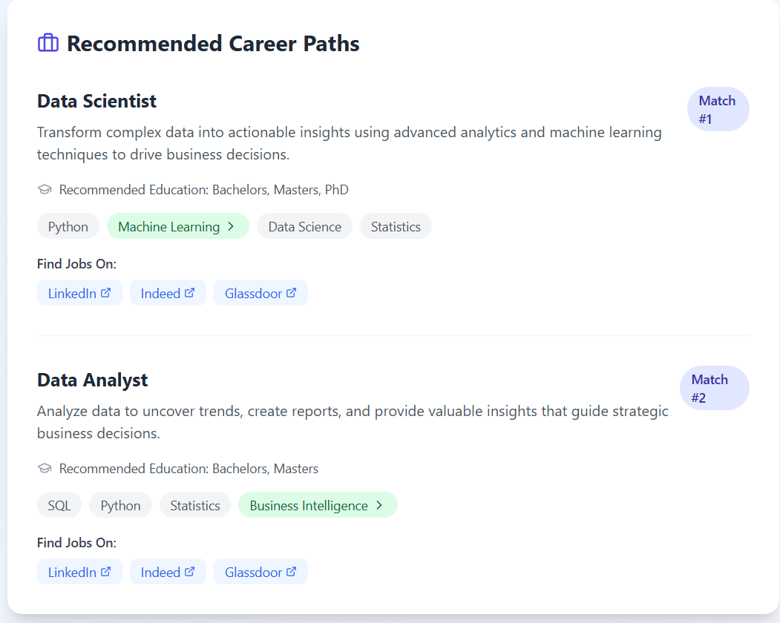
Skills and Interest Assessment
Interactive quizzes and assessments
1
Personalized feedback on strengths and potential areas for growth
2
Identification of key skills and interests relevant to career choices
3
Notes:
6

Slide 7



Conclusion and Future Roadmap
AI-powered career guidance
1
Empowers users to make informed career decisions
2
Personalized insights
Provides tailored recommendations and support
3
Future Development
Integration of job search and networking features
Notes:
8

